Slide 1

Objectives
In this session, you will learn to:
  Identify the various software development approaches
  Identify the role of OOAD in SDLC
Notes:
Initiate the session by explaining the session objectives to the students.
This lesson will familiarize the students with Software Development Life Cycle (SDLC) and object-oriented concepts. The first section, Understanding Software Development Life Cycle (SDLC), discusses the need for SDLC and the various SDLC models. For the first section, the discussion in the class should revolve around the advantages of iterative/incremental model over the waterfall or prototyping models.
The second section, Understanding Object-Oriented Concepts, should be taught in a discussion mode with the help of the case study. The purpose of introducing this section is to give the students a refresher session on object-oriented concepts.

Slide 2
Understanding Software Development Life Cycle (SDLC)
SDLC is a disciplined and systematic approach that divides the software development process into various phases, such as requirements, design, and coding.
The phase-wise software development process helps you track schedule, cost, and quality of the software projects.
Notes:
Tell the students that earlier, software development was not accepted as an engineering stream. At that time, the development of software was an ad-hoc activity. No rules and standards were used for software development. This resulted in a lot of problems because of which project teams were not able to meet their quality, productivity, and deadline targets. Therefore, inferior quality software was produced with schedule and budget overshoots. To address these problems, the Software Development Life Cycle (SDLC) was introduced.
Explain the definition of SDLC given on the slide. Also explain that dividing the process of software development into various phases helps in tracking the schedule, cost, and quality of the software projects in a better manner. The time and budget allocated for the entire project can be distributed among the various phases of the SDLC. This distribution can be done according to the data related to similar projects undertaken in the past. Allocating time and budget separately for each phase helps track the schedule and cost in a better manner. If time and budget is exceeded in one phase, an effort can be made to reduce it in the other phases.

Slide 3
Overview of SDLC Phases
There are six phases of SDLC:
  Feasibility analysis
  Requirement analysis and specification
  Design
  Coding
  Testing
  Maintenance
Notes:
The students need to have a broad view of a software design before you start with the discussion of software development process. Therefore, you should address the following issues before discussing the various phases of SDLC:
* What is to be developed: Emphasize on feasibility analysis of the software system that needs to be developed within the given environment, requirements, and characteristics from the perspective of end users.
* How it will be developed: Emphasize on the analysis of the design methodology and the operating system and programming language that needs to be used to develop the software.
* What changes will be incorporated during the enhancement of software: Emphasize on the changes that might be suggested due to error correction, enhancement of software, and changes in the requirements of the client. You need to analyze the impact of every suggested change and then apply them on a priority basis keeping in view the cost, schedule, and quality of software.
Explain that the standard SDLC consists of six phases. Explain the six phases given in the slide. Tell the students that the activities in each phases can be tailored if needed according to the specific needs of the project.

Slide 4
Software Development Approaches
Different types of projects have different requirements.
It is required to tailor the SDLC phases to meet the specific needs of the project.
The tailoring the SDLC phases, gives rise to various software development approaches:
  Waterfall approach
  Prototyping approach
  Spiral approach
  Win-win spiral approach
  Incremental approach
Notes:
Tell the students that development projects have different types of requirements and therefore, it may be required to tailor the SDLC phases according to the specific needs of the project. Explain that the tailored form of SDLC phases are known as SDLC models. Explain the three types of SDLC models, linear, iterative, and incremental.

Slide 5
Waterfall Approach
Describes the software development process in a linear sequential flow.
Is the earliest approach used for software development.
Defines the software development process in seven phases:
  Conception
  Initiation
  Analysis
  Design
  Construction
  Integration and testing
  Implementation and maintenance
Notes:
Explain the seven phases in the waterfall model.

Slide 6
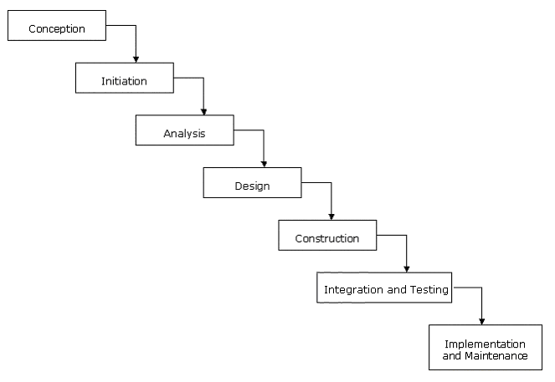
Waterfall Approach (Contd.)
The following figure shows various phases of the waterfall approach:
Notes:
Explain that waterfall model follows a linear flow, where any phase in the development process begins only if the previous phase is complete. In addition, once the project progresses to the next phase, you cannot go back to the previous phase of the model.
Explain that the waterfall model is used in small project, where requirements are frozen in the beginning of the project.

Slide 7
Prototyping Approach
Also known as evolutionary approach.
Is a sample implementation of the system that shows limited and main functional capabilities of the proposed system.
Is used in the requirements gathering and analysis phase to capture the exact requirement of the proposed system.
Notes:
Tell the students that when requirements are not clearly defined and are expected to change during the development process, the waterfall model cannot be used. In this case, it is better to use the prototyping model.
Explain that a prototype is a sample implementation of the proposed system that demonstrates the main functional capabilities of the system. The prototype can be quickly developed and delivered to the customer for evaluation. This helps obtain early feedback on the requirements of the proposed system.
Use the example of the e-commerce Web application given in the student guide to explain how the prototyping model can be implemented.

Slide 8
Prototyping Approach (Contd.)
Various types of prototypes:
  Throwaway prototypes
  Evolutionary prototypes
Limitations of prototyping approach:
  Gives clients the false impression that a few minor changes to the prototype will give them the required system.
  May compromise on the overall quality of the software in the rush to develop the prototype.
Notes:
Explain that because a prototype appears like the actual software system, it may give the false impression to the clients that a few minor changes will give them the required system. Moreover, developers may compromise on the quality of the software in the rush to develop the prototype. For example, the developer may use inefficient algorithms or inappropriate programming languages for developing the prototype quickly.

Slide 9
Spiral Approach
Includes the iterative nature of the prototyping approach and the linear nature of the waterfall approach.
Is ideal for developing software that are released in various versions.
The six phases of spiral approach are:
  Customer communication
  Planning
  Risk analysis
  Engineering
  Construction and release
  Customer evaluation
Notes:
Explain the concept of spiral model by using the example of Windows operating system that was released in multiple iterations after obtaining feedback from the customers on each iteration. Explain the six phases of the spiral model.

Slide 10
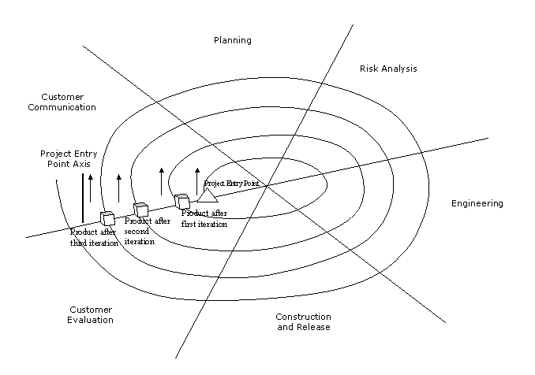
Spiral Approach (Contd.)
The following figure shows the various phases of the spiral approach:
Notes:
Explain how the software goes through the six phases of the spiral model in multiple iterations.

Slide 11
Win-Win Spiral Approach
Is an extension of the spiral approach.
The phases in this approach are same as the phases in the spiral approach.
In this approach, the development team and the customer hold discussions and negotiate on the requirements that need to be included in the current iteration.
The approach is called win-win because it is a winning situation for the development team and also for the customer.
The win-win spiral approach is generally used when you have time-bound releases.
Notes:
Explain the win-win spiral model as an extension of the spiral model. Explain how it results in a winning situation for both the client and the development team.

Slide 12
Incremental Approach
In an incremental approach, software requirements are broken down into various functional units.
Each functional unit is implemented in an increment and the final product is achieved after all the functional units are implemented in the development process.
Each increment in the incremental approach includes three phases:
  Design
  Implementation
  Analysis
Notes:
Explain the concept of incremental models by using the example where a bank wants to develop software to automate the process for insurance services, personal banking, and home and automobile loans. The bank wants the automation of personal banking system immediately because it will enhance the customer services. You can develop the software by using the incremental model. In the first increment, you can implement the personal banking feature and deliver it to the customer. In the later increments, you can implement the insurance services, home loans, and automobile loans features of the bank.

Slide 13
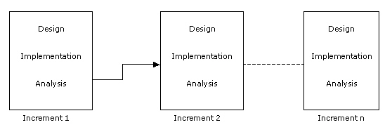
Incremental Approach (Contd.)
The following figure shows the Incremental approach with various phases:
Notes:
Explain that when the incremental model is used, a project activity list is created that lists all the activities to be performed for the completion of the project. The activities are then prioritized based on how urgently they are required to be implemented. In the first increment, the top most activity from the project activity list is selected and its design is prepared. In the implementation phase, the design is implemented and tested. In the analysis phase, the functional capability of the partially developed product is analyzed. After this, the first increment of the product can be released. The development process can be then repeated until all the activities of the project activity list are implemented.
Explain that an incremental model can be used to develop large systems only. This is because it is difficult to break small systems in to smaller functional increments.

Slide 14
Just a minute
Which of the following approaches includes the iterative nature of the prototyping approach and the linear nature of waterfall approach?
  Incremental approach
  Spiral approach
  Evolutionary approach
Answer:
  Spiral approach
Notes:
Check the learning of the students by asking the question given in the slide.

Slide 15
Understanding Object-Oriented Concepts
In the design phase, there are two approaches to software development:
  Function-oriented approach:
    Is module-centric and concentrates on functions of the software.
  Object-oriented approach:
    Portrays things as they exist in the real world.
    Introduces the concept of inheritance which allows reuse of existing code components.
    Supports inheritance, reusability and encapsulation of data, abstraction, and polymorphism.
Notes:
Explain the two approaches to software development. Explain that the function-oriented approach is the erstwhile approach that evolved before the object-oriented approach. Explain the features of function-oriented approach and its limitations. Explain how object-oriented approach overcomes the limitations of function-oriented approach.

Slide 16
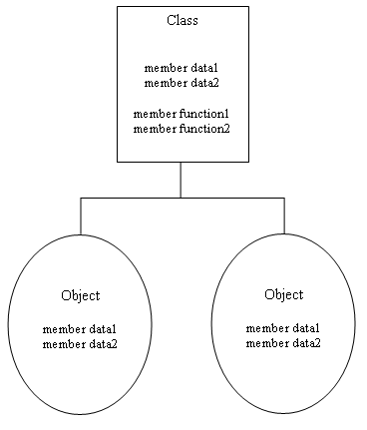
Overview of Object-Oriented Concepts
A class is an abstract data type that contains a set of attributes and functions.
An object is an instance of a class.
Notes:
Explain the definition of class and object with an example.

Slide 17
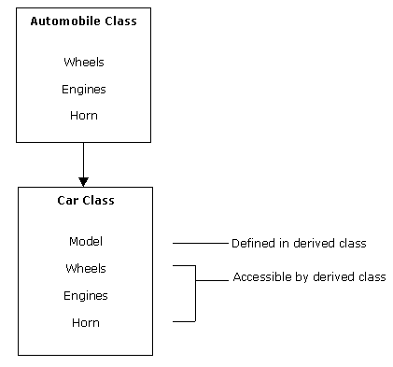
Overview of Object-Oriented Concepts (Contd.)
Inheritance refers to sharing of attributes and behaviors among classes based upon hierarchical relationship.
Notes:
Explain the definition of inheritance by using an example. Explain that inheritance of classes allows you to reuse code.

Slide 18
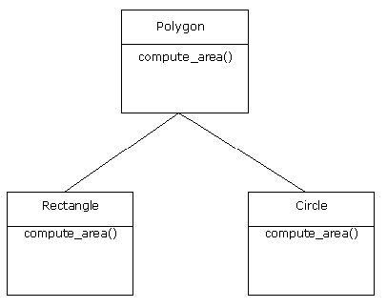
Overview of Object-Oriented Concepts (Contd.)
Abstraction focuses on essential, inherent aspects of an entity ignoring its implementation details.
Notes:
Explain the definition of abstraction by using an example.

Slide 19
Overview of Object-Oriented Concepts (Contd.)
Encapsulation means preventing access to non-essential details.
Polymorphism is the concept of using operators or functions in different ways depending on what they are operating on.
Using operators in different ways depending on what they are operating on is called operator overloading.
Using functions in different ways is called function overloading.
Notes:
Explain the concept of encapsulation and polymorphism by using the examples given in the student guide. Explain the concepts of function overloading and operator overloading.

Slide 20
Overview of Object-Oriented Concepts (Contd.)
Consider an example of OO concept:
  Countryside Markets has no formal system to store its employees information. The organization now wants to store detailed information about its employees, such as name, age, date of birth, e-mail id, department, empolyee code, salary drawn, and date of joining.

Slide 21

Overview of Object-Oriented Concepts (Contd.)
Countryside Markets class hierarchy:
Notes:
Explain the inheritance relationship between the classes at different levels by using the figure given on the slide. Explain that the operations defined in the Employee class are abstract operations that are implemented in the Full Time and Part Time classes. Tell the students that the Developer class inherits from both the Full Time class and the Part Time class. This is called multiple inheritance. Also tell the students that the attributes defined in the Employee class have public access and can therefore be modified by the Full Time class and the Part Time class. However, the attributes defined in the Full Time class and the Part Time class have private access and therefore cannot be modified by their derived classes. Finally, tell the students that the display(int) function defined in the Manager and Engineer classes overrides the display(int) function defined in the Full Time class.

Slide 22
Just a minute
Which phase of SDLC includes translation of the requirements specified in the SRS into a logical structure that can be implemented in a programming language?
  Feasibility
  Design
  Coding
  Maintenance
Answer:
  Design
Notes:
Check the learning of the students by asking the question given in the slide.

Slide 23
Role of Object-Oriented Analysis and Design (OOAD) in SDLC
OO approach does not replace the standard approaches, such as Data Flow Diagrams (DFD) or Entity Relationship (ER) diagrams. It is only an addition to the existing toolkit.
OOAD uses the OO approach to solve the real world problems. It uses OO approach to analyze the system requirements and break a large and complex system into smaller and simpler components.
OOAD is analysis of requirements and design of software system in terms of the objects, classes, encapsulation, inheritance, polymorphism, abstraction, and dynamic binding.
OOAD is a methodology that can be applied to linear, iterative, or incremental approach.
Notes:
Share the following additional information regarding object-oriented modular design with the students.
The various modules of a software system are interdependent. You need to tell the students that they can use object-oriented modular design to depict interdependency among various modules of a system. An object-oriented modular design has two characteristics:
* Coupling: Indicates the measure of interdependence among modules. Strongly interconnected modules are called tightly coupled and modules with weak interconnections are called loosely coupled. For example, if module B is strongly connected to module A, you need to have complete knowledge of module A to understand module B. In contrast, weakly connected modules do not share high interdependence. Modules with no interconnections are called independent modules. The types of coupling are:
**Content coupling: Means a module directly references the content of another module. A change in one module requires a change in the other module. For example, if variable x is defined in two modules, A and B, and the value of x is changed in module A, the change must be reflected in module B.
**Common coupling: Means both modules have access to the same global data. An example of common coupling is modules x and y having read and write access to the same database element.
**Control coupling: Means the transfer of control elements takes place between modules. For example, module x, in addition to passing information to module y, also informs y about what action to take.
**Stamp coupling: Means the two modules can simultaneously modify or access data defined in a shared class. If the shared class changes, the modules accessing the attributes of shared class also change.
**Data coupling: Means every argument is either a data structure or a simple argument.
*Cohesion: Represents the interaction of components within a module, which is the measure of how well components fit in a module. A cohesive module performs a single task within a procedure and requires little interaction with other procedures in the program. The types of cohesion are:
**Coincidental cohesion: Exists if there is no relationship between its components. In other words, multiple unrelated actions are performed.
**Logical cohesion: Contains components that are logically related. For example, a module that performs input or output operations.
**Temporal cohesion: Contains components related logically in time and executed together. Initialisation, clean up, and termination are examples of temporally bound modules.
**Procedural cohesion: Contains components that belong to a common procedural unit. The procedural unit contains actions that are related and executed in a certain order. For example, a sequence of decision statements may be combined to form a separate module.
**Communicational cohesion: Contains actions performed in series and on the same data. A module to print and punch record is an example of communicational cohesion.
**Functional cohesion: Contains components that perform a single function.

Slide 24
Summary
In this session, you learned that:
  SDLC is a disciplined and systematic approach towards software development.
  SDLC divides the software development process into six phases:
    Feasibility analysis
    Requirement analysis and specification
    Design
    Coding
    Testing
    Maintenance
Notes:
Summarize the session by using the summary points listed in the slide.

Slide 25
Summary (Contd.)
  Different types of projects have different requirements. Therefore, it may be required to tailor the SDLC phases according to the specific needs of the project. This gives rise to various software development approaches. Some of these approaches are:
    Waterfall approach
    Prototyping approach
    Spiral approach
    Win-win spiral approach
    Incremental approach
  The function-oriented approach is module-centric and concentrates on the functions of the software.
Notes:
Summarize the session by using the summary points listed in the slide.

Slide 26
Summary (Contd.)
  The object-oriented (OO) approach supports reusability and encapsulation of data and concepts such as inheritance, abstraction, and polymorphism.
  OOAD is analysis of requirements and design of software system in terms of objects, classes, encapsulation, inheritance, polymorphism, abstraction, and dynamic binding.
Notes:
Summarize the session by using the summary points listed in the slide.

